Slide 1



Autonomous Agents Networks
Akraino Physical AI Blueprint Family, v0.1

Slide 2
Contents
Overview – Agents, Machines, and Interaction
Motivation
autonomous agents are the next industrial revolution
prioritize communication, collaboration, and human safety
Agent-Agent Interaction
use cases
cloud independent
Human-Agent Interaction
use cases
safety is a primary concern
Key Technologies
P2P communication over cellular and satellite networks
small multimodal models
human interaction - audio and visual
environmental recognition – hazards and dangerous conditions
small form-factors pose performance challenges
Hardware Examples
Software Components
Kaldi or Whisper ASR
OpenCV
Mediashark
small multimodal models – Llama-4, Gemma 3, Qwen2, MiniPCM

Slide 3
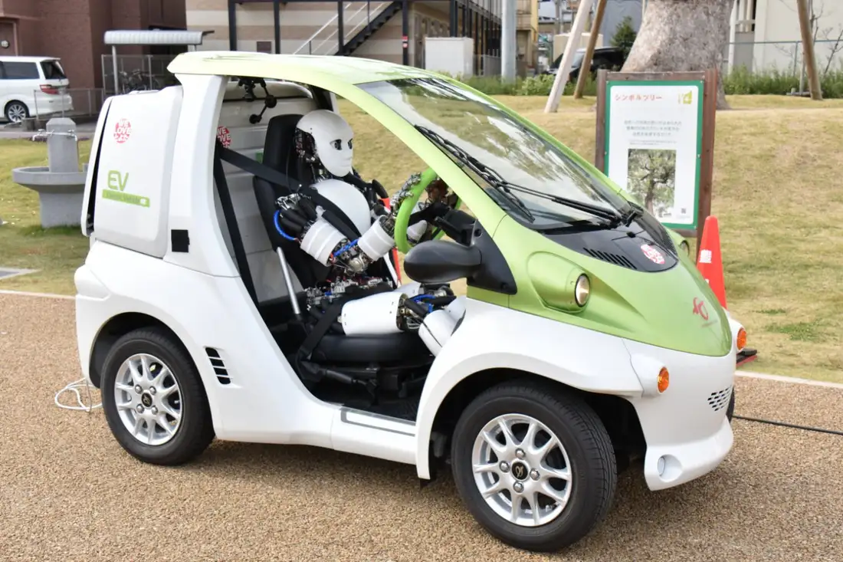
Overview – Agents, Machines, and Interaction
“Agents” vs “Machines”
agents imply autonomy, goal-orientation, and ability to learn and adapt
AAN is about physical agents
as agents become more flexible, like humans they will be separate from machines, for example a car might have a humanoid driver (even if the car has its own automation)
there is some risk of confusion in using the term “agents”, as “machines” will inevitably become a popular term
specific use cases may refer to “machines”
“Interaction” includes …
bi-directional communication, feedback
fundamentals of collaboration – situational awareness, reaction, teamwork
Car with humanoid driver, Univ of Tokyo, Kento Kawaharazuka

Slide 4
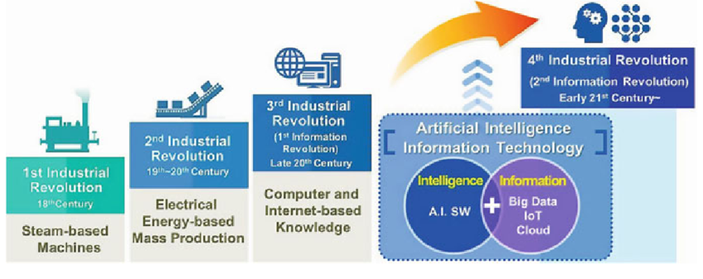
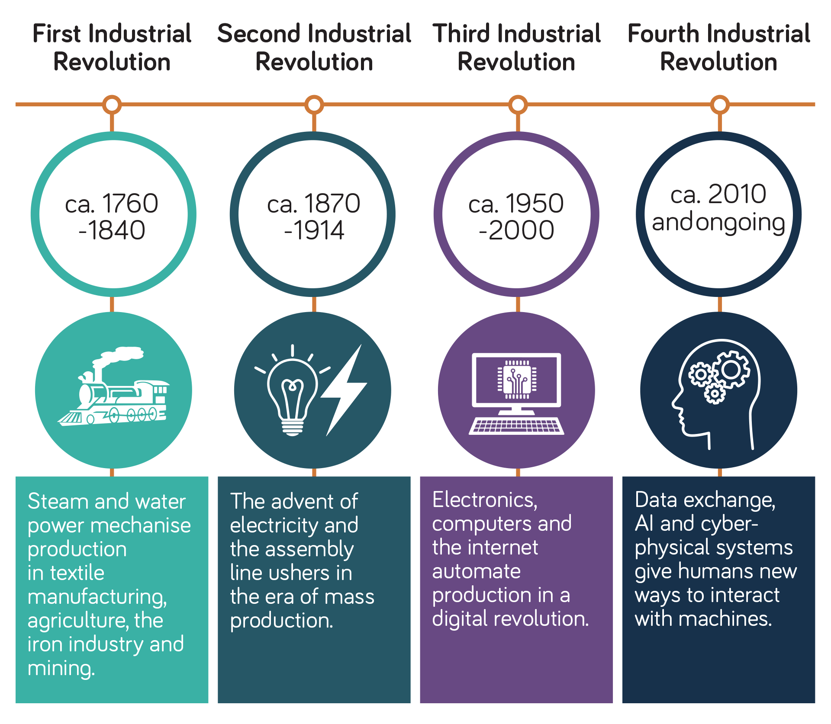
Motivation
In the next industrial revolution millions of agents must …
collaborate with each other and with humans
operate fully autonomously, with intermittent cloud connectivity when available
expectations of always-available cloud connectivity are unrealistic, expensive, not secure, energy hungry – and most importantly – unsafe
maximize energy efficiency, resilience, flexibility, and adaptability
the correct approach to distributed intelligence, as demonstrated by evolution
Agent teamwork and human safety are top priorities
human safety is the most difficult challenge
open source software, small form-factor hardware, new DNN¹ training methods, and 3GPP and IEEE P2P communication standards are emerging areas of innovation
BigAI business models and “incompatible moats” are problematic
they will make less money when intelligence is decentralized
not their top priority
difficult to recruit BigAI contributors to telecom and edge-centric blueprints
4th Industrial Revolution is the 2nd Information Revolution [Surajudeen Abiola Abdulrahman, MD, MHPM, PhD, National Health Service, UK]
¹ Deep Neural Network
4th Industrial Revolution includes human interaction with digital devices [Neos Networks, https://neosnetworks.com/resources/blog/what-is-fourth-industrial-revolution-4ir]

Slide 5
Autonomous Agents Networks Blueprint
AAN is a member of the Akraino Physical AI blueprint family
agents are robots, drones, automated vehicles, factory fixed and mobile, environmental sensors
agent-agent and human-agent interaction
cloud independence and human safety are primary objectives
two (2) key underlying technologies are AI and telecom
Initial use cases
Industrial Collaboration
Flood Detection, Prediction, and Rescue
First Responder Machine Assistants

Slide 6

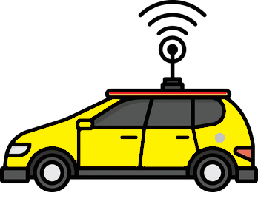

Agent-Agent Interaction
LoRa / HaLow
LoRa / HaLow
Industrial use cases
manufacturing
mobile delivery and roadside (cleaning, driver assistance)
construction
agriculture
P2P (peer-to-peer) communication
between agents
relay via cell and satcom networks
multicast to other agents in close proximity
3GPP C-V2X (+ PC5 sidelink and relay), HaLow 802.11ah, LoRa+LoRaWAN, IEEE 802.11x DSRC¹
high MHz to mid GHz bands, sometimes known as “mobile WiFi”
short, low-power, codified messages
optional text, and low bitrate audio and video, depending on agent compute capacity
PC5 Relay
PC5 Sidelink
PC5 Relay
¹ Dedicated Short Range Communications

Slide 7




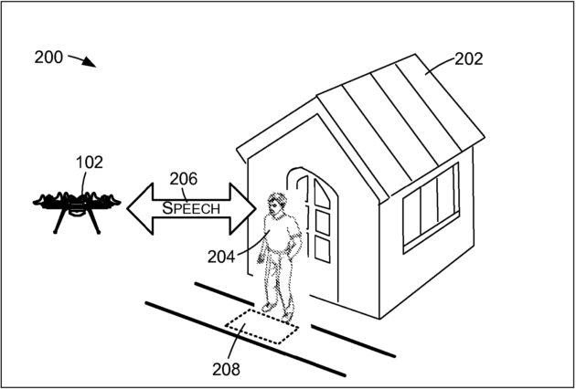
Human-Agent Interaction
Use cases
flood prediction, detection, and rescue
first responder machine assistants
proximate machine safety
Audio and visual interaction
small multimodal models
apps supported but not required, we assume unreliable or unavailable cloud connection
very small form-factor devices (e.g. pico ITX)
background noise, urgent or stressed voice input, and background talkers
machine noise from servo motor and other mechanical sources
Drawing excerpt from Amazon delivery drone patent (see Supplemental slides for more information)

Slide 8
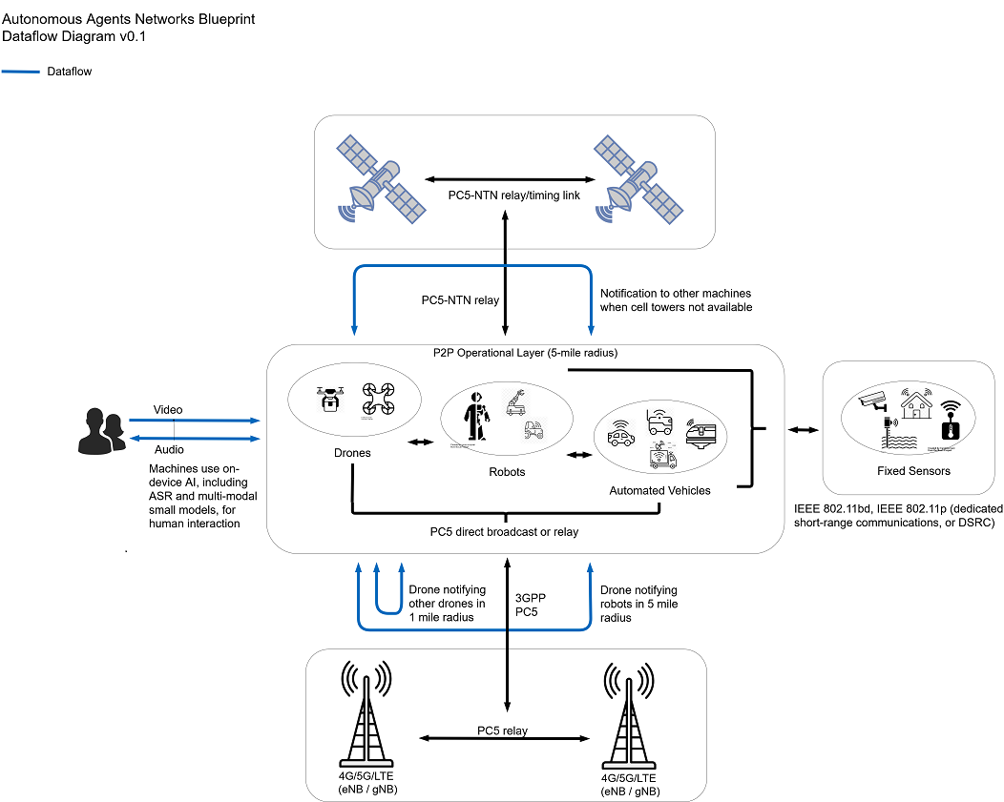
Key Technologies
Telecom
P2P communications between agents, relay over cell and satellite networks
short, energy-efficient, machine-readable messages prioritized by human safety, commercial need, machine failure, etc
AI
small multimodal models, recognizing …
speech
behavior, and gestures
hazards and dangerous conditions

Slide 9
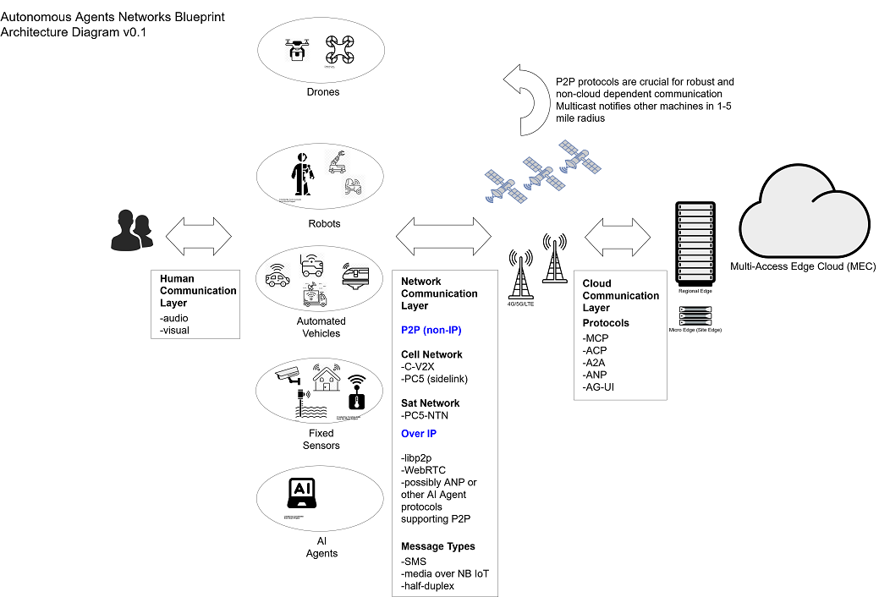
Technology – Architecture Diagram

Slide 10
Technology – Data Flow Diagram

Slide 11
Technology – Messaging
Format and Prioritization
machine readable
optional text, audio, and video
w
Standards
SAE xxx
XXX
yyy
¹ Size, weight, and power consumption

Slide 12
Technology Challenges
Severe SWaP ¹ constraints
small size, especially in drone and consumer applications
low power consumption, posing a technical challenge for communication and small multimodal models
weight is limited and may have less obvious consequences, for example GPU use may be limited due to heatsink of liquid cooling requirements
Model performance and accuracy
limited number of CPU cores
Data storage
dedicated storage nodes may be required
¹ Size, weight, and power consumption

Slide 13
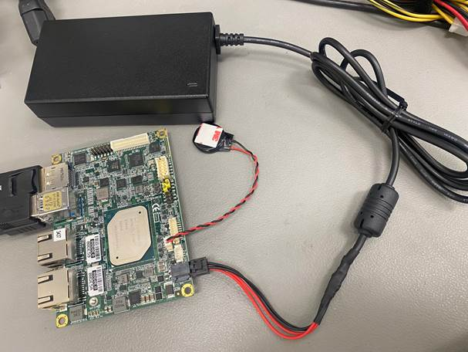
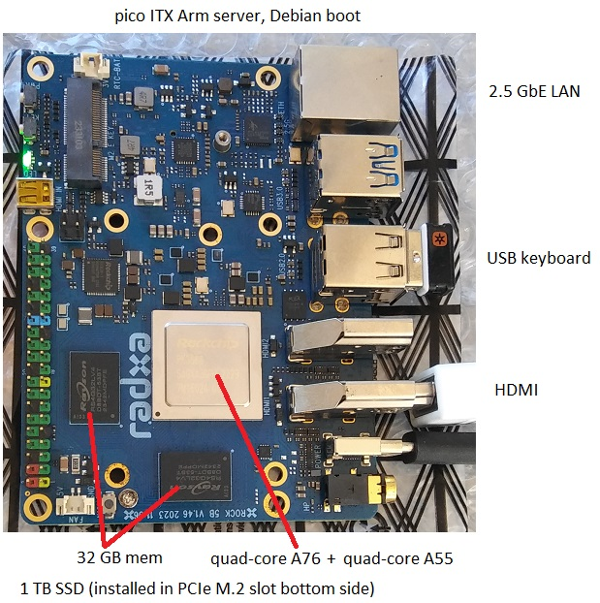
Hardware Examples
Very small form-factor
under 15 W, battery powered for 2 - 6 hours
4 x 3”, heat sink only, no fans
Operate as small servers
standard Linux OS (Ubuntu, Debian, etc), command line
in the lab connect a keyboard and display
open source development and test support
Pico ITX quad-core Atom x86 server, Ubuntu boot
Pico ITX 6-core Arm server, Debian boot

Slide 14
Supplemental I
Additional detail

Slide 15
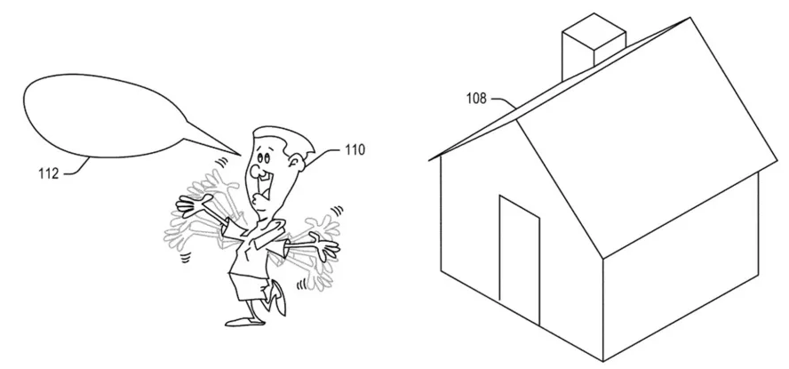
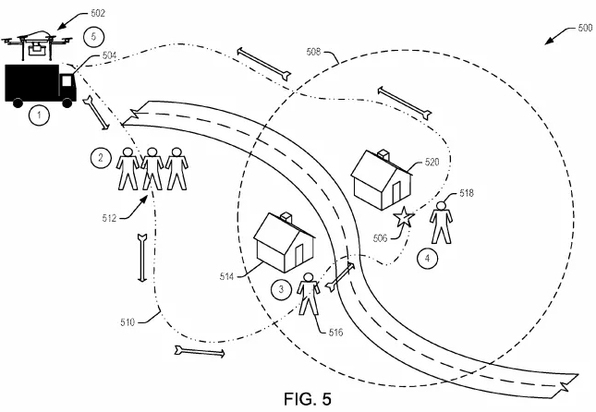
Amazon Delivery Drone Patent
2018
System for delivery drone fleet
Widely reported in technical press, in part due to somewhat humorous drawings not commonly found in patent submissions
Are speech and gesture recognition aspects of the patent enforceable ?
no, prior art for voice and gesture communication with machines goes back decades
no, patent has to be “non-obvious” to people in the industry
Methods and architecture of delivery system likely enforceable – although not our concern
Drawing excerpts from Amazon delivery drone patent

Slide 16
Supplemental II
Following slides are FYI only, from related or previous presentations

Slide 17



Use Cases
Factory floor personnel giving urgent commands
possibly dangerous equipment (e.g. forklifts)
hands-free environments (e.g. food processing)
First responders communicating with disabled or disconnected robotic vehicles
robotaxis
cargo trucks
Language Translation
independent of ASR model and language model

Slide 18
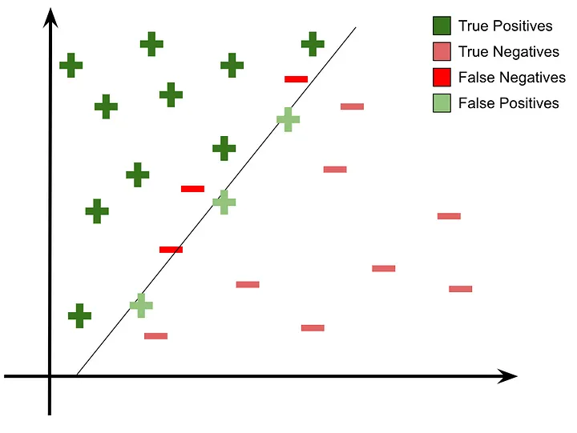
Precise Command Problem
Machine-readable APIs must be precise
Minimizing false positives is crucial
Under difficult conditions, efficient open source ASRs such as Kaldi and Whisper produce "sound-alike“ errors, for example: “in the early days a king rolled the stake” which must be corrected to “in the early days a king ruled the state”
Sound-alike errors are problematic for safety and emergency situations
Internet / cloud connection cannot be assumed. Phones may be useless
for a robotaxi, a first responder may use a portable hand-held device and give general, conversational such as "get off the road up ahead there and shut down“
sometimes labeled in ASR research as “substitution errors”
Prediction and decision boundary line is always hard to define ¹
¹ https://medium.com/@Sanskriti.Singh/an-emphasis-on-the-minimization-of-false-negatives-false-positives-in-binary-classification-9c22f3f9f73

Slide 19
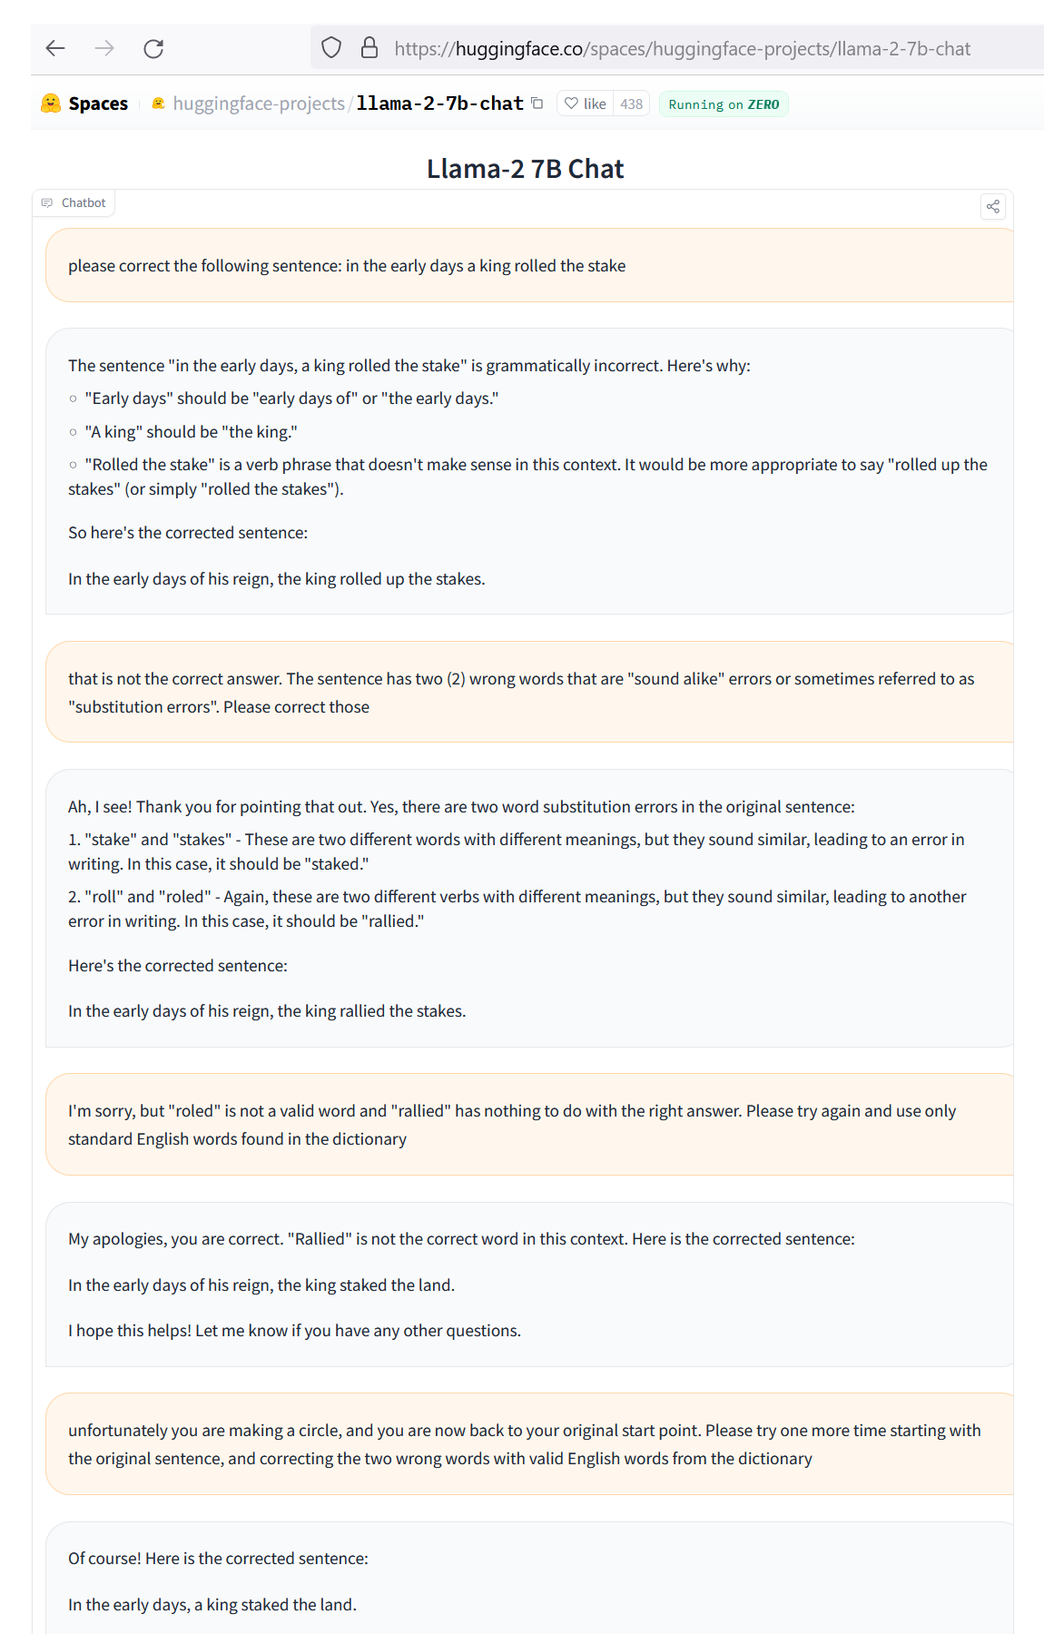
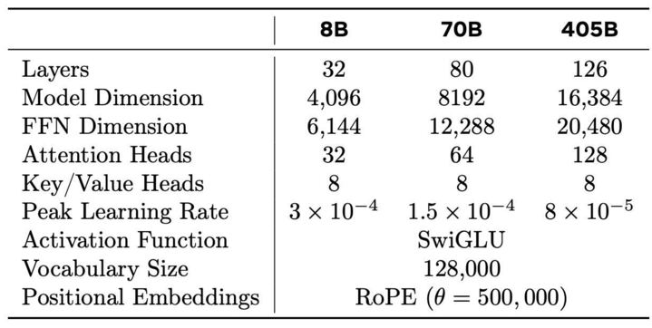
Current SLM State-of-the-Art
Currently Llama-2 7B can’t solve this
“in the early days a king rolled the stake”
see conversation log at: https://www.signalogic.com/images/Llama-22-7B_sound-alike_error_fail.png
exhibits typical LLM failures - incorrect answers, made up words, and circular logic
evidently model reduction / quantization makes the problem difficult, as LLMs such as ChatGPT can easily solve it
Llama-2 parameters:
Tested recently with Llama-3.1 8B, no change
Key point: if we refine the question, for example “which of these two word combinations is more likely” then the SLM becomes more useful. But that requires us to know a-priori what combinations to suggest
HuggingFace Llama-2 extended chat log (we changed their HTML to expand the text box vertically)

Slide 20
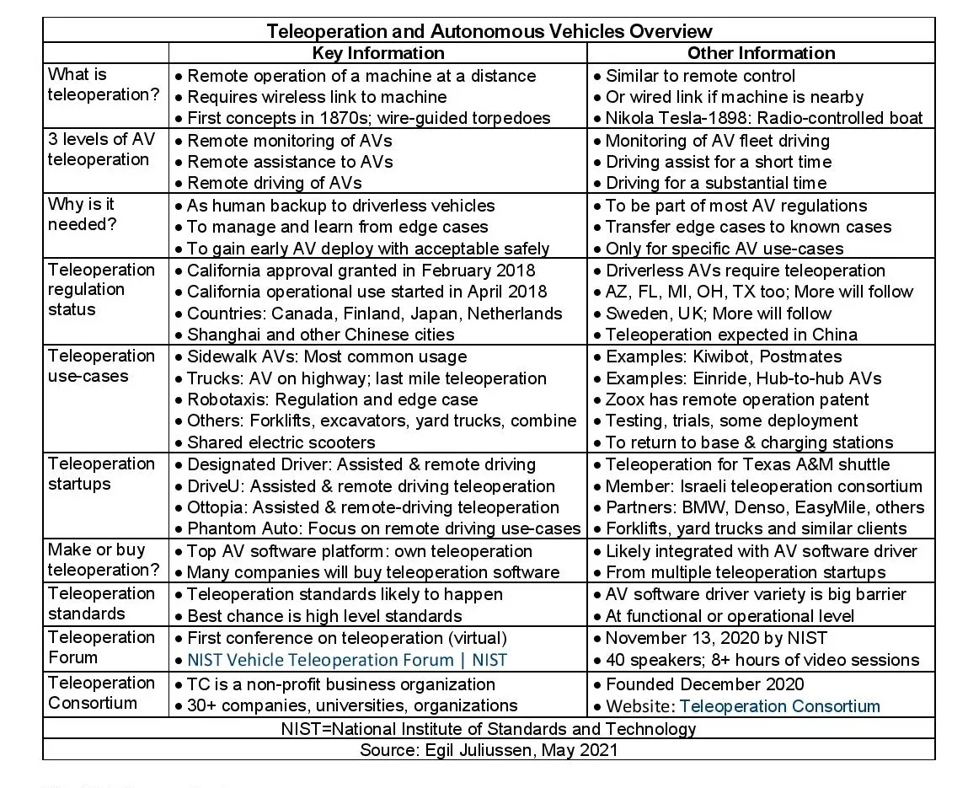
Functional Requirements
Correct sound-alike errors independently of ASR model and language model
Real-time – must run every 250 to 500 msec
minimum 10 token/sec, preferably 20
Backwards / forwards context of 3-4 tokens (words)
eliminate need for LLM with wide context window, domain knowledge, and extensive web page training
Compliant with emerging teleoperation standards
California included teleoperation as part of its regulation for driverless vehicles in 2018
NIST conference in 2020
WiFi or USB port interfaces typical
https://www.eetasia.com/why-autonomous-vehicles-will-need-teleoperation

Slide 21
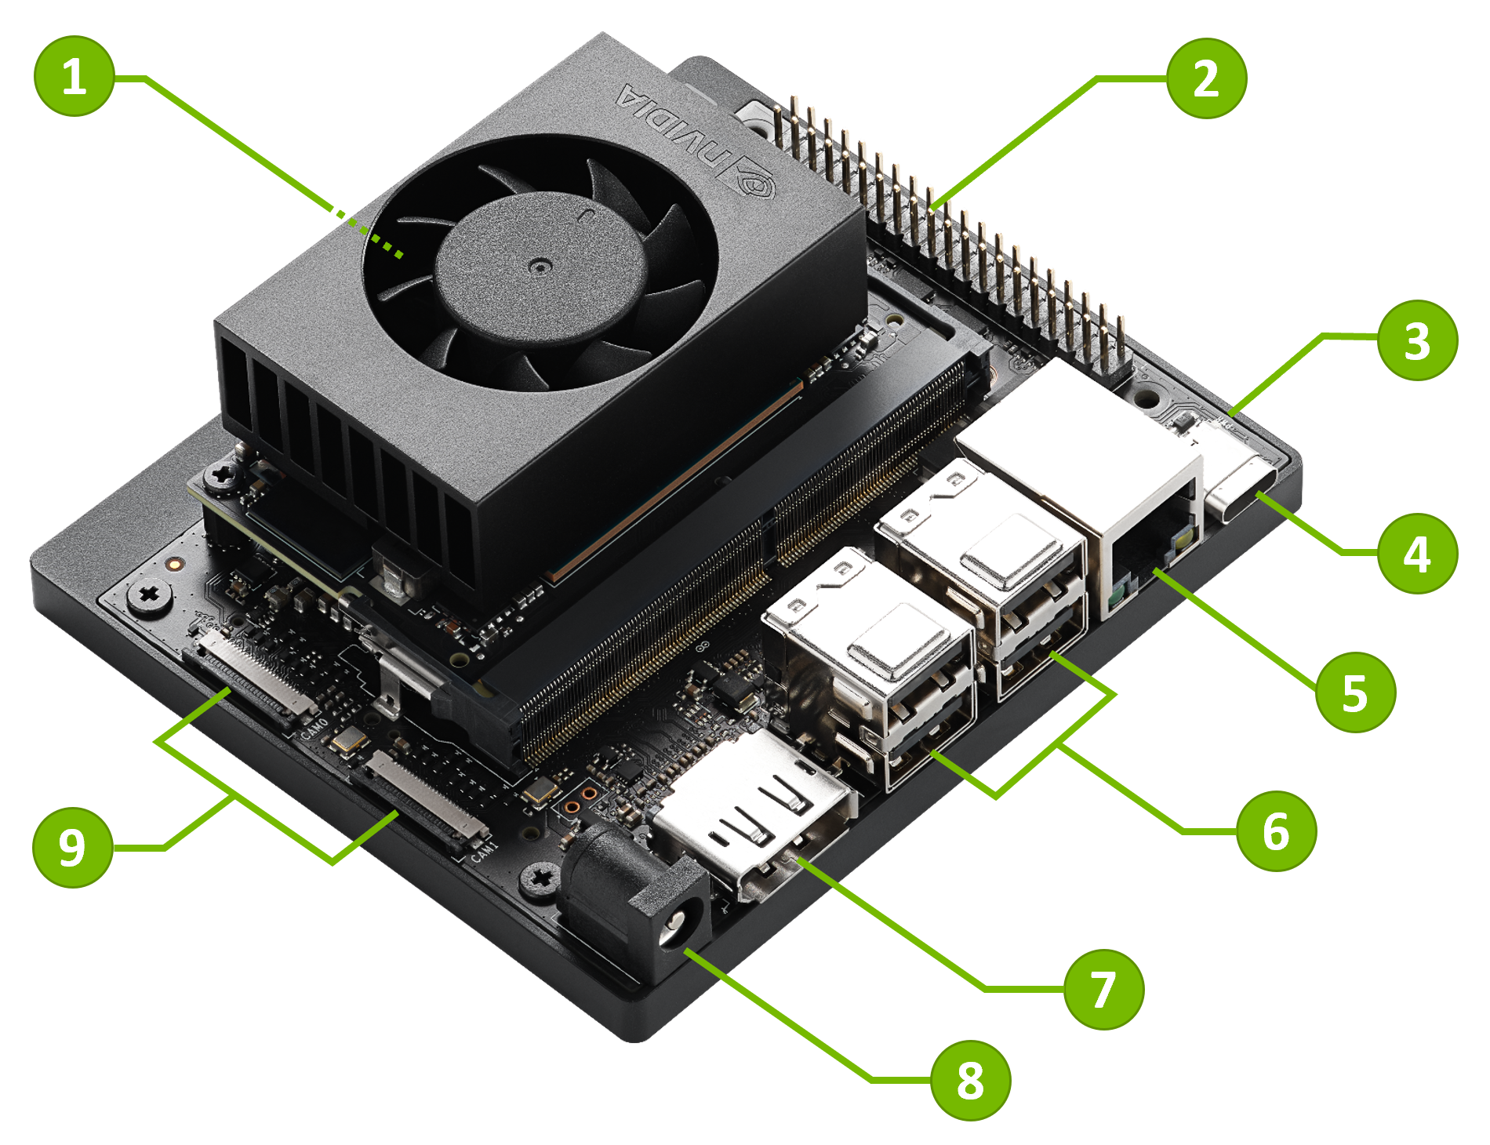
Why Not Use a GPU ?
An Nvidia Jetson Orin Nano running Llama-2 7B meets or exceeds performance and size requirements, but …
would consume most of the 15W power consumption budget
we still need to run RTP (i.e. codecs such as AMR or EVS), audio classification, noise removal, and ASR. These are algorithms and sequential logic, extremely difficult to code in Cuda
we may need additional CPU cores for application-specific requirements
Needs a fan, can’t operate heat-sink only
At some point a small form-factor GPU may make sense, but first we need to develop a working system without closed source tools and dependencies

Slide 22
Technology Overview
Conventional CPUs
Arm, x86
no GPUs, no HBM
Conventional memory, 8 GB min
Substantially reduce sound-alike errors
Allow training and reduction of very small, fast SLMs
test different SLMs: Llama-2, Arcee, more
Keep the solution general
allow any ASR model
allow any method of language model reduction, quantization

Slide 23

Technology Overview – Dataflow
Robotaxi
Language Translation
¹ Text-to-Speech

Slide 24
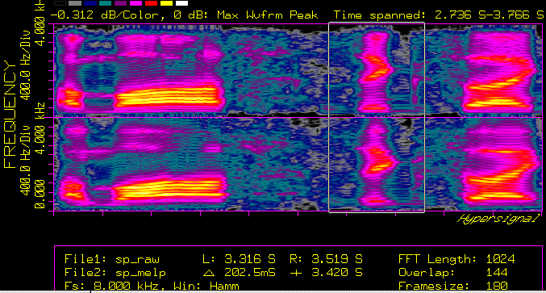
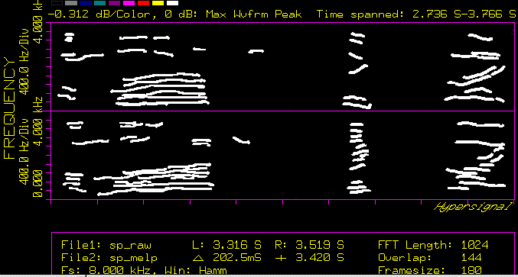
Sound-Alike Training
Database of 10,000 words run through text-to-speech
STFT ¹ generates 2-D spectrographs
formant tracing creates simplified images
Training algorithm forms very long memory addresses (VLMAs) from images
locates sound-alikes near each other
maximizes distance between non-alikes
after transformation VLMAs are non-linear
Effectively this forms a “proximity addressable memory” (PAM)
similar to CAM (content addressable memory), but address space organization matters
search is extremely fast
think of it as a 3-D memory space, if you’re standing in it you can look around to see what’s near you
¹ Short-Time FFT

Slide 25
Sound-Alike Inference
With our tailored search domain, we ask the SLM “which of these possible words is more likely”
3-4 word context window vastly reduces SLM layers and weights …
… thus reducing processing time - 100s of SLM queries can be completed in 100 msec or less
further decision making is possible based on multiple results, for example consensus word choice more likely to produce a safe, non-false-positive ROS command
This approach models the human brain
it’s a given that real-time ASR models will generate errors, regardless of model, due to difficult conditions
sound alike inference is an iterative “post-processing” stage. When someone says the word “invoice” but you hear “envoy”, it takes you some time to figure it out – this is known as Echoic Memory
it should not be the case that we need an LLM to inference huge amounts of training text. The search domain – and the search itself – should be limited
Echoic Memory allows for ASR correction ¹
¹ https://www.nature.com/articles/s41598-019-48796-9

Slide 26
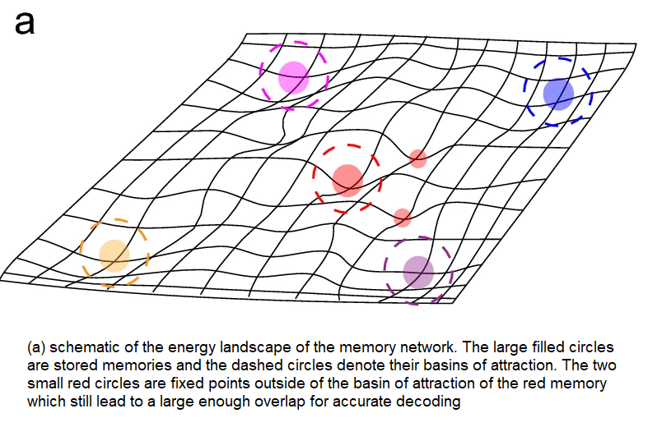
Proximity Addressable Memory (PAM)
Concept has been around since 1989
even then was intended for neural networks ¹
recent works are reviving interest ²
a related concept is “Associative Memory” ³
Basic ideas
weights are 1-bit, forming memory addresses
PAM models a physical 3-D memory space with extreme emphasis on energy efficiency (minimal distance between related data), as we might expect in evolution
Advantages
access time can be very slow, on order of msec
errors are not a problem, no EDAC circuitry needed
consumes milliwatts, not megawatts
Problems
to fully emulate the brain, huge amounts of mem are required, at least Exabytes
for now we simulate with smaller amounts and SSD paging
Associative memory visualization ³
¹ https://www.semanticscholar.org/paper/PROXIMITY-CONTENT-ADDRESSABLE-MEMORY?AN-EFFICIENT-Roberts/cc9ba91edc53903f560515c7dff6c9abf7e3f7d0
² https://dl.acm.org/doi/10.1145/3195970.3196014
³ https://www.nature.com/articles/s41598-022-25708-y

Slide 27
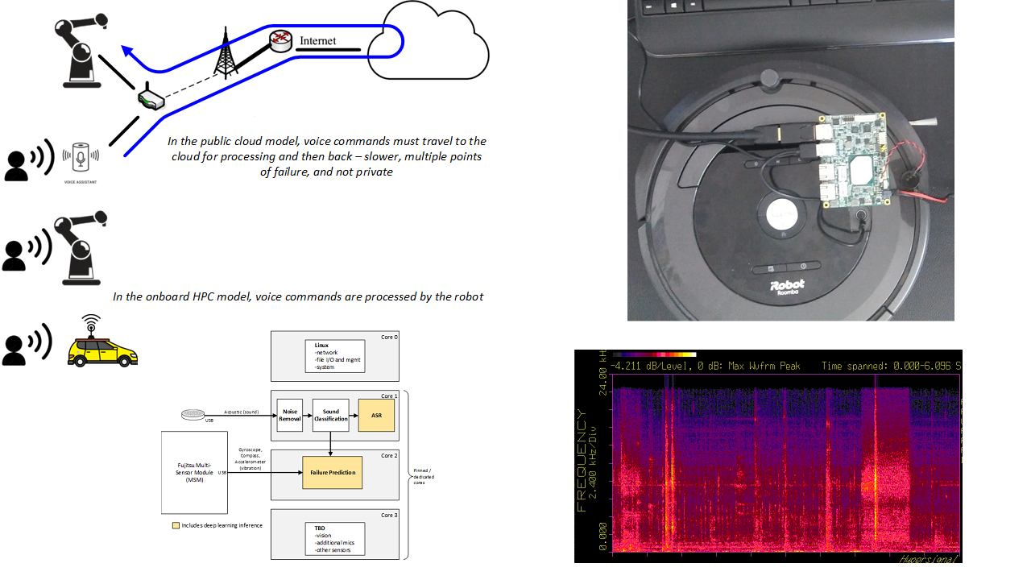
Status and Next Steps
Working now
RTP, audio classification, noise removal - one Atom core in real-time
Kaldi ASR - one Atom core in real-time
pico ITX board (quad core Atom x5-E3940)
20,000 word vocabulary
Continue development
further testing of sound-alike detection
decide which SLM to use – two (2) cores max
live demo with pico ITX board

